Slide 1

Algorithm Analysis IT-2101
Dr. Mohammad Abu Yousuf
yousuf@juniv.edu

Slide 2
All Pairs Shortest Paths

Slide 3
Introduction
we consider the problem of ﬁnding shortest paths between all pairs of vertices in a graph.
given : directed graph G = ( V, E ),
weight function ω : E → R, |V| = n
goal : create an n × n matrix D = ( d_{ij} ) of shortest path distances
i.e., d_{ij} = δ ( v_{i} , v_{j} )
trivial solution : run a Single Source Shortest Path (SSSP) algorithm n times, one for each vertex as the source.

Slide 4
Introduction
►We can solve an all-pairs shortest-paths problem by running a single-source shortest-paths algorithm |V| times, once for each vertex as the source.
all edge weights are nonnegative : use Dijkstra’s algorithm
PQ = linear array : O ( V³ + VE ) = O ( V³ )
► negative edge weights : use Bellman-Ford algorithm
O ( V²E ) = O ( V⁴ ) on dense graphs

Slide 5
Dynamic programming algorithms for all-pairs shortest path
Ideas:
(1) Characterize the structure of an optimal solution.
(2) Recursively define the value of an optimal solution.
(3) Compute the value of an optimal solution in a bottom-up manner.
(4) Construct an optimal solution from information constructed in (3).

Slide 6
Shortest Paths
Assumption : negative edge weights may be present, but no negative weight cycles.
(1) Structure of a Shortest Path :
Consider a shortest path p_{ij}^{m} from v_{i} to v_{j} such that |p_{ij}^{m}| ≤ m
► i.e., path p_{ij}^{m} has at most m edges.
no negative-weight cycle ⇒ all shortest paths are simple
⇒ m is finite ⇒ m ≤ n – 1
i = j ⇒ |p_{ii}|= 0 & ω(p_{ii}) = 0
i ≠ j ⇒ decompose path p_{ij}^{m} into p_{ik}^{m-1} & v_{k} → v_{j} , where|p_{ik}^{m-1}| ≤ m - 1
► p_{ik}^{m-1} should be a shortest path from v_{i} to v_{k} by optimal substructure
property.
► Therefore, δ (v_{i} ,v_{j} ) = δ (v_{i} ,v_{k} ) + ω_{k j}

Slide 7
Shortest Paths
(2) A Recursive Solution to All Pairs Shortest Paths Problem :
d_{ij}^{m} = minimum weight of any path from v_{i} to v_{j} that contains at most “m” edges.
m = 0 : There exist a shortest path from v_{i} to v_{j} with no edges ↔ i = j .
0 if i = j
► d_{ij}⁰ =
∞ if i ≠ j
m ≥ 1 : d_{ij}^{m} = min { d_{ij}^{m-1} , min_{1≤k≤n Λ k≠j} { d_{ik}^{m-1} + ω_{kj} }}
= min_{1≤k≤n} {d_{ik}^{m-1} + ω_{kj} } for all v_{k} ∈ V,
since ω_{j j} = 0 for all v_{j} ∈ V.

Slide 8
Shortest Paths
to consider all possible shortest paths with ≤ m edges from v_{i} to v_{j}
► consider shortest path with ≤ m -1 edges, from v_{i} to v_{k} , where
v_{k} ∈ R_{vi} and (v_{k} ,v_{j} ) ∈ E
note : δ (v_{i} ,v_{j} ) = d_{ij}^{n-1} = d_{ij}^{n} = d_{ij}^{n+1} , since m ≤ n -1 = | V | - 1
v_{k}’s
v_{i}
v_{j}

Slide 9
Shortest Paths
(3) Computing the shortest-path weights bottom-up :
given W = D¹ , compute a series of matrices D², D³, ..., D^{n-1} ,
where D^{m} = ( d_{ij}^{m} ) for m = 1, 2,..., n-1
► final matrix D^{n-1} contains actual shortest path weights,
i.e., d_{ij}^{n-1} = δ (v_{i} ,v_{j} )
SLOW-APSP( W )
D¹ ← W
for m ← 2 to n-1 do
D^{m} ← EXTEND( D^{m-1} , W )
return D^{n-1}

Slide 10
Shortest Paths
EXTEND ( D , W )
► D = ( d _{ij} ) is an n x n matrix
for i ← 1 to n do
for j ← 1 to n do
d _{ij} ← ∞
for k ← 1 to n do
d _{ij} ← min{d _{ij} , d _{ik} + ω_{k j}}
return D

Slide 11
Shortest Paths
relation to matrix multiplication C = A B : c_{ij} = ∑_{1≤k≤n} a_{ik} x b_{k j} ,
► D^{m-1} ↔ A & W ↔ B & D^{m} ↔ C
“min” ↔ “t” & “t” ↔ “x” & “∞” ↔ “0”
Thus, we compute the sequence of matrix products
D¹ = D⁰ x W = W ; note D⁰ = identity matrix, 0 if i = j
D² = D¹ x W = W² i.e., d_{ij}⁰ =
D³ = D² x W = W³ ∞ if i ≠ j
D^{n-1}= D^{n-2} x W = W^{n-1}
running time : Θ( n⁴ ) = Θ( V⁴ )
► each matrix product : Θ( n³ )
► number of matrix products : n-1

Slide 12
Shortest Paths
Example
2
3
4
1
3
8
2
-5
1
-4
7
5
4
6

Slide 13
Shortest Paths
 | 1 | 2 | 3 | 4 | 5
1 | 0 | 3 | 8 | ∞ | -4
2 | ∞ | 0 | ∞ | 1 | 7
3 | ∞ | 4 | 0 | ∞ | ∞
4 | 2 | ∞ | -5 | 0 | ∞
5 | ∞ | ∞ | ∞ | 6 | 0
2
3
4
1
3
2
8
-5
1
-4
7
5
4
6
D¹= D⁰W

Slide 14
Shortest Paths
 | 1 | 2 | 3 | 4 | 5
1 | 0 | 3 | 8 | 2 | -4
2 | 3 | 0 | -4 | 1 | 7
3 | ∞ | 4 | 0 | 5 | 11
4 | 2 | -1 | -5 | 0 | -2
5 | 8 | ∞ | 1 | 6 | 0
2
3
4
1
3
2
8
-5
1
-4
7
5
4
6
D²= D¹W

Slide 15
Shortest Paths
 | 1 | 2 | 3 | 4 | 5
1 | 0 | 3 | -3 | 2 | -4
2 | 3 | 0 | -4 | 1 | -1
3 | 7 | 4 | 0 | 5 | 11
4 | 2 | -1 | -5 | 0 | -2
5 | 8 | 5 | 1 | 6 | 0
2
3
4
1
3
2
8
-5
1
-4
7
5
4
6
D³= D²W

Slide 16
Shortest Paths
 | 1 | 2 | 3 | 4 | 5
1 | 0 | 1 | -3 | 2 | -4
2 | 3 | 0 | -4 | 1 | -1
3 | 7 | 4 | 0 | 5 | 3
4 | 2 | -1 | -5 | 0 | -2
5 | 8 | 5 | 1 | 6 | 0
2
3
4
1
3
2
8
-5
1
-4
7
5
4
6
D⁴= D³W

Slide 17
Improving Running Time Through Repeated Squaring
idea : goal is not to compute all D^{m} matrices
► we are interested only in matrix D^{n-1}
recall : no negative-weight cycles ⇒ D^{m} = D^{n-1} for all m ≥ n-1
we can compute D^{n-1} with only lg(n-1) matrix products as
D¹ = W
D² = W² = W x W
D⁴ = W⁴ = W² x W²
D⁸ = W⁸ = W⁴ x W⁴
= =
This technique is called repeated squaring.

Slide 18
Improving Running Time Through Repeated Squaring
FASTER-APSP ( W )
D¹ ← W
m ← 1
while m < n-1 do
D^{2m} ← EXTEND ( D^{m} , D^{m} )
m ← 2m
return D^{m}
final iteration computes D^{2m} for some n-1 ≤ 2m ≤ 2n-2 ⇒ D^{2m} = D^{n-1}
running time : Θ( n³lgn ) = Θ( V³lgV )
► each matrix product : Θ( n³ )
► # of matrix products : lg( n-1 )
► simple code, no complex data structures, small hidden constants in Θ-notation.

Slide 19
Idea Behind Repeated Squaring
decompose p_{ij}^{2m} as p_{ik}^{m} & p_{kj}^{m}, where
p_{ij}^{2m} : v_{i} v_{j}
p_{ik}^{m} : v_{i} v_{k}
p_{kj}^{m} : v_{k} v_{j}
v_{k}’s
v_{i}
v_{j}

Slide 20
Floyd-Warshall algorithm for shortest path
Use a different dynamic-programming formulation to solve the all-pairs shortest-paths problem on a directed graph G=(V,E).
The resulting algorithm, known as the Floyd-Warshall algorithm, runs in O (V³) time.
negative-weight edges may be present,
but we shall assume that there are no negative-weight cycles.

Slide 21
The structure of a shortest path
The algorithm considers the “intermediate” vertices of a shortest path, where an intermediate vertex of a simple path p=<v₁,v₂,…,v_{l}> is any vertex in p other than v₁ or v_{l}, that is, any vertex in the set {v₂,v₃,…,v_{l-1}}

Slide 22
Continue:
Let the vertices of G be V={1,2,…,n}, and consider a subset {1,2,…,k} of vertices for some k.
For any pair of vertices i,j ∈ V, consider all paths from i to j whose intermediate vertices are all drawn from {1,2,…,k},and let p be a minimum-weight path from among them.
The Floyd-Warshall algorithm exploits a relationship between path p and shortest paths from i to j with all intermediate vertices in the set {1,2,…,k-1}.

Slide 23
Relationship:
The relationship depends on whether or not k is an intermediate vertex of path p.
If k is not an intermediate vertex of path p, then all intermediate vertices of path p are in the set {1,2,…,k-1}. Thus, a shortest path from vertex i to vertex j with all intermediate vertices in the set {1,2,…,k-1} is also a shortest path from i to j with all intermediate vertices in the set {1,2,…,k}.
If k is an intermediate vertex of path p, then we break p down into i k j as shown Figure 2 (next slide). p1 is a shortest path from i to k with all intermediate vertices in the set {1,2,…,k-1}, so as p2.

Slide 24
All intermediate vertices in {1,2,…,k-1}
p1
k
p2
i
j
P:all intermediate vertices in {1,2,…,k}
Figure 2. Path p is a shortest path from vertex i to vertex j,and
k is the highest-numbered intermediate vertex of p. Path p1,
the portion of path p from vertex i to vertex k,has all intermediate
vertices in the set {1,2,…,k-1}.The same holds for path p2 from
vertex k to vertex j.

Slide 25
A recursive solution to the all-pairs shortest paths problem:
Let d_{ij}^{(k)} be the weight of a shortest path from vertex i to vertex j with all intermediate vertices in the set {1,2,…,k}. A recursive definition is given by
d_{ij}^{(k)}= w_{ij} if k=0,
min(d_{ij}^{(k-1)},d_{ik}^{(k-1)}+d_{kj}^{(k-1)}) if k 1.
The matrix D^{(n)}=(d_{ij}^{(n)}) gives the final answer-d_{ij}^{(n)}= for all i, j V-because all intermediate vertices are in the set {1,2,…,n}.

Slide 26
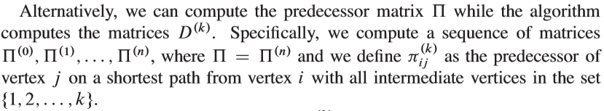

A recursive solution to the all-pairs shortest paths problem:

Slide 27


A recursive solution to the all-pairs shortest paths problem:

Slide 28
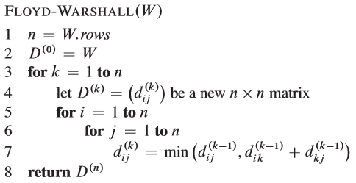
Computing the shortest-path weights bottom up:

Slide 29
Example:
Figure 3
2
4
3
1
3
8
1
-4
-5
7
2
5
4
6

Slide 30
D(0)=
(0)=
D(1)=
(1)=

Slide 31
D(2)=
(2)=
D(3)=
(3)=

Slide 32
D(4)=
(4)=
D(5)=
(5)=

Slide 33
Floyd-Warshall Algorithm
maintaining n D matrices can be avoided by dropping all superscripts.
m-th iteration of outermost for-loop
begins with D = D^{m-1}
ends with D = D^{m}
computation of d_{ij}^{m} depends on d_{im}^{m-1} and d_{mj}^{m-1} .
no problem if d_{im} & d_{mj} are already updated to d_{im}^{m} & d_{mj}^{m} since d_{im}^{m} = d_{im}^{m-1} & d_{mj}^{m} = d_{mj}^{m-1}.
running time : Θ( n³ ) = Θ( V³ )
simple code, no complex data structures, small hidden constants

Slide 34
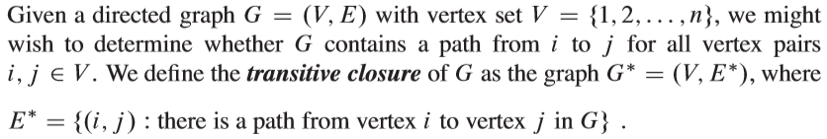
Transitive Closure of a Directed Graph

Slide 35
Transitive Closure of a Directed Graph
G' = ( V , E' ) : transitive closure of G = ( V , E ), where
► E' = { (v_{i} , v_{j} ): there exists a path from v_{i} to v_{j} in G }
trivial solution : assign W such that 1 if (v_{i} , v_{j} ) ∈ E
ω_{ij} =
∞ otherwise
► run Floyd-Warshall algorithm on W
► d_{ij}^{n} < n ⇒ there exists a path from v_{i} to v_{j} ,
i.e., (v_{i} , v_{j} ) ∈ E'
► d_{ij}^{n} = ∞ ⇒ no path from v_{i} to v_{i} ,
i.e., (v_{i} , v_{j} ) ∉ E'
► running time : Θ( n³ ) = Θ( V³ )

Slide 36
Transitive Closure of a Directed Graph
Better Θ( V³ ) algorithm : saves time and space.
1 if i = j or (v_{i} , v_{j} ) ∈ E
► W = adjacency matrix : ω_{ij} =
0 otherwise
► run Floyd-Warshall algorithm by replacing “min” → “ ” & “+” → “ ”
1 if a path from v_{i} to v_{j} with all intermediate vertices from V_{m}
define t_{ij}^{m} =
0 otherwise
► t_{ij}^{n} = 1 ⇒ (v_{i} , v_{j} ) ∈ E' & t_{ij}^{n} = 0 ⇒ (v_{i} , v_{j} ) ∉ E'
recursive definition for t_{ij}^{m} = t_{ij}^{m-1} (t_{im}^{m-1} t_{mj}^{m-1} ) with t_{ij}⁰ = ω_{ij}

Slide 37
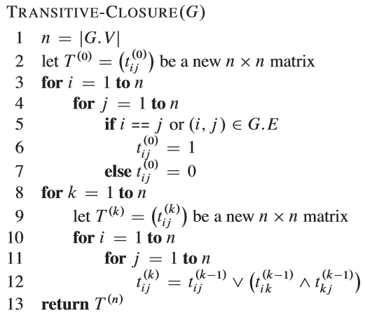
Transitive Closure of a Directed Graph

Slide 38
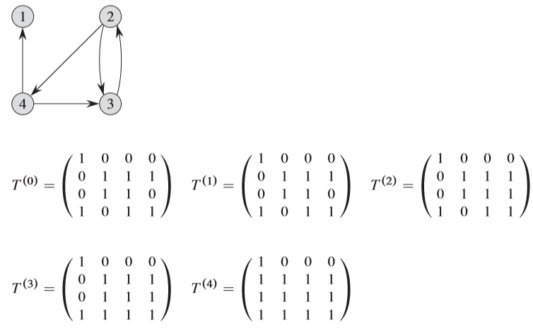
Transitive Closure of a Directed Graph

Slide 39
Transitive Closure of a Directed Graph
Algorithm shows the matrices T^{(k)} computed by the TRANSITIVE-CLOSURE procedure on a sample graph. The TRANSITIVE-CLOSURE procedure, like the Floyd-Warshall algorithm, runs in ϴ(n³) time.

Slide 40
Thank you

